Slide 1

Professor Profiler
Neha Anand

Slide 2
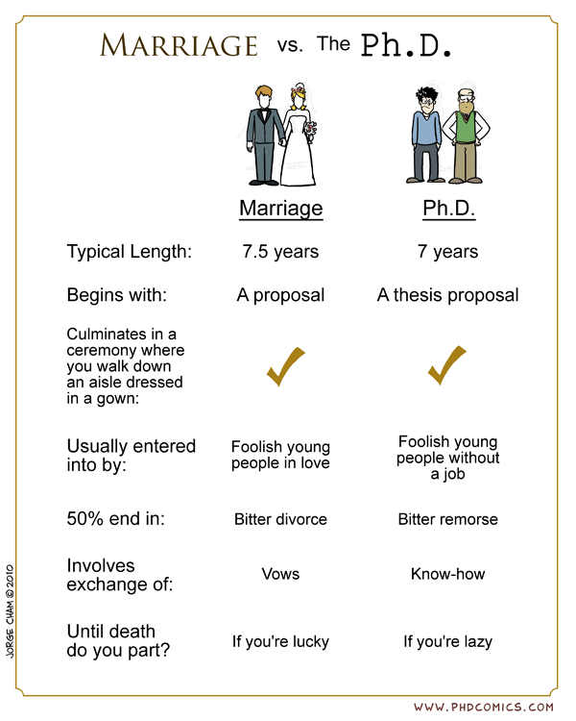


Problem Statement
Build a holistic profile of a university professor
Contact Information
University Information
Research area tags based on publications
Impact of research
Ratings/reviews given by past students
Target Users:
For Prospective graduate students
For research collaboration

Slide 3

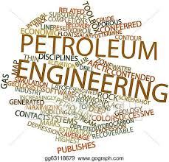




current scope
Petroleum Engineering
Top - 4 US schools
Research Professors
Publications after 2010
Two major journals
Total of 88 professors
~5700 publications

Slide 4

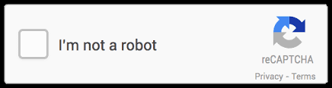
data acquisition
University Rankings
usnews.com
Faculty Information
University Websites
Faculty Rating
ratemyprofessor.com
Publication Information
Google Scholar/Scopus
Paper Abstracts + Titles
Journal Websites

Slide 5

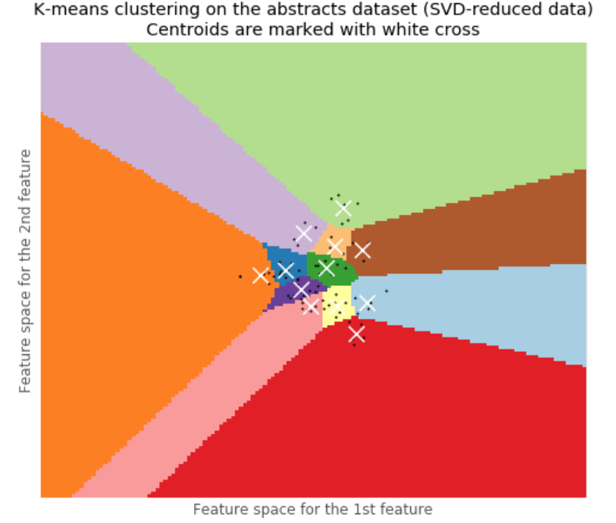
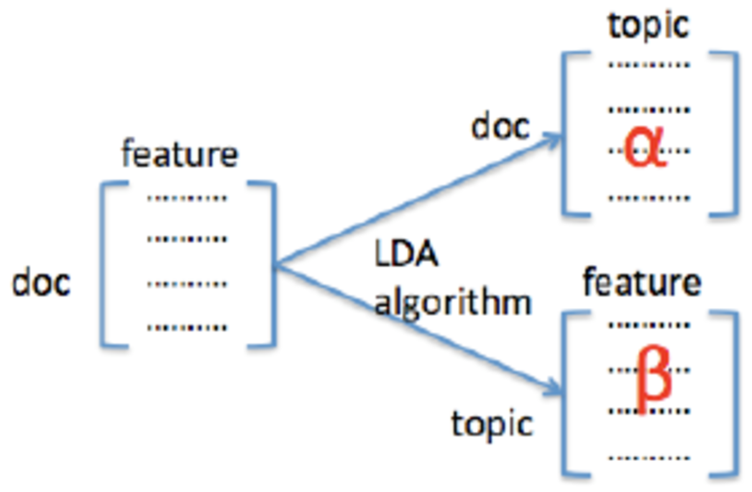
unsupervised modeling process
Data Cleaning and Exploratory Data Analysis
Clustering
K-Means clustering model
Optimize number of clusters using Elbow Method and Silhouette Analysis
Topic Modeling
NMF, LDA and LDA Mallet model
Optimize number of topics using Coherence Plots
NLP pipeline using NLTK, Spacy
Tf-idf and Count Vectorization, Lemmatization, N-grams, POS tagging

Slide 6
model comparison and evaluation
Unsupervised Modeling
Clustering
Topic Modeling
K-Means
Non-negative Matrix Factorization (NMF)
Latent Dirichlet Allocation (LDA)
LDA Mallet
Visualization of Clusters/Topics
Coherence Score
Domain Knowledge
Run Time

Slide 7
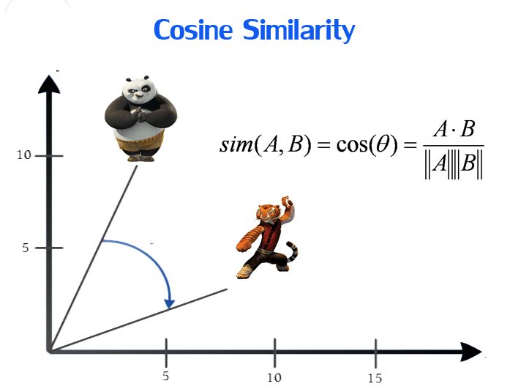
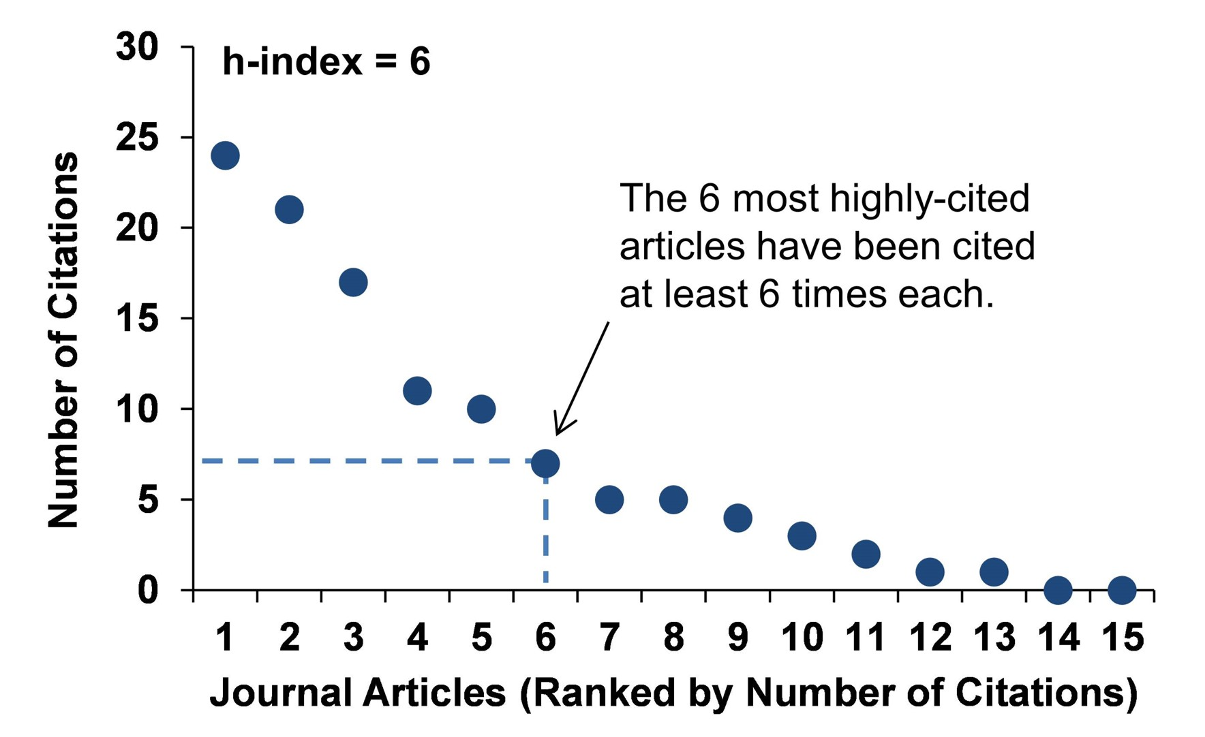
search results ranking cRITERIA

Slide 8
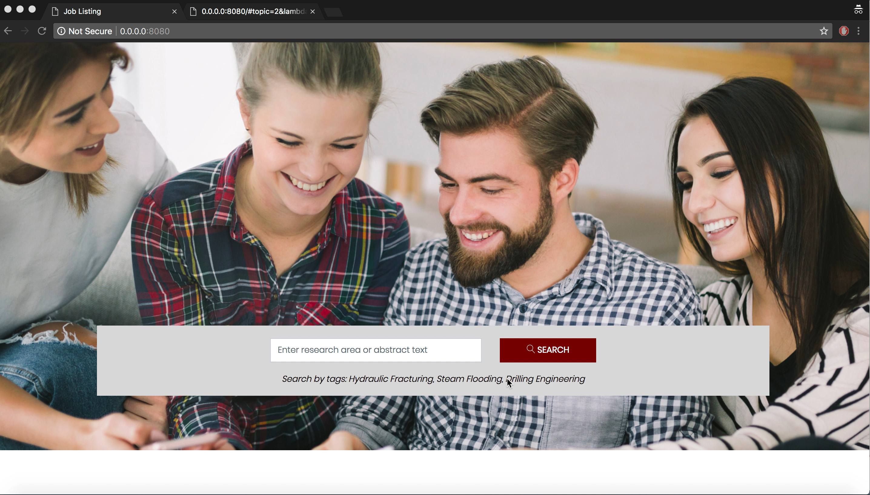
Notes:
Website demo:

Slide 9
Future work
Scale the project to include more:
Majors
Schools
Journals
Graph analysis of the research areas and professors
Time-series analysis

Slide 10
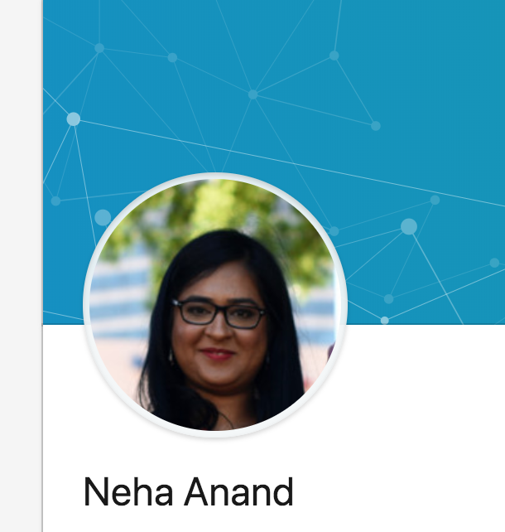


my profile
nehaanand8
neha8anand/professor-profiler
B.E. (Hons.) Chemical Engineering
M.S. Petroleum Engineering

Slide 11
Questions

Slide 12
conclusion

